Slide 1

Introduction to
qctoolkit.in
qcworkbench@cdac.in
vivekn@cdac.in
PPT Link https://tinyurl.com/qsim2024

Slide 2
What it Offers?
QSim is a robust QC Simulator integrated with a GUI based Workbench
Students / Researchers can create Quantum Circuits and Quantum Programs and view the simulated outputs
Notes:
‹#›

Slide 3
QSim simulator is an open-source software written in Python, which is added as a new backend to IBM’s Qiskit platform
It extends the existing Qiskit capability, while retaining the convenience (e.g. portability, documentation, graphical interface) of the Qiskit format
Simulator : arxiv.org/abs/1908.05154
https://github.com/indian-institute-of-science-qc/qiskit-aakash
dm_simulator_user_guide
https://arxiv.org/abs/1908.05154

Slide 4
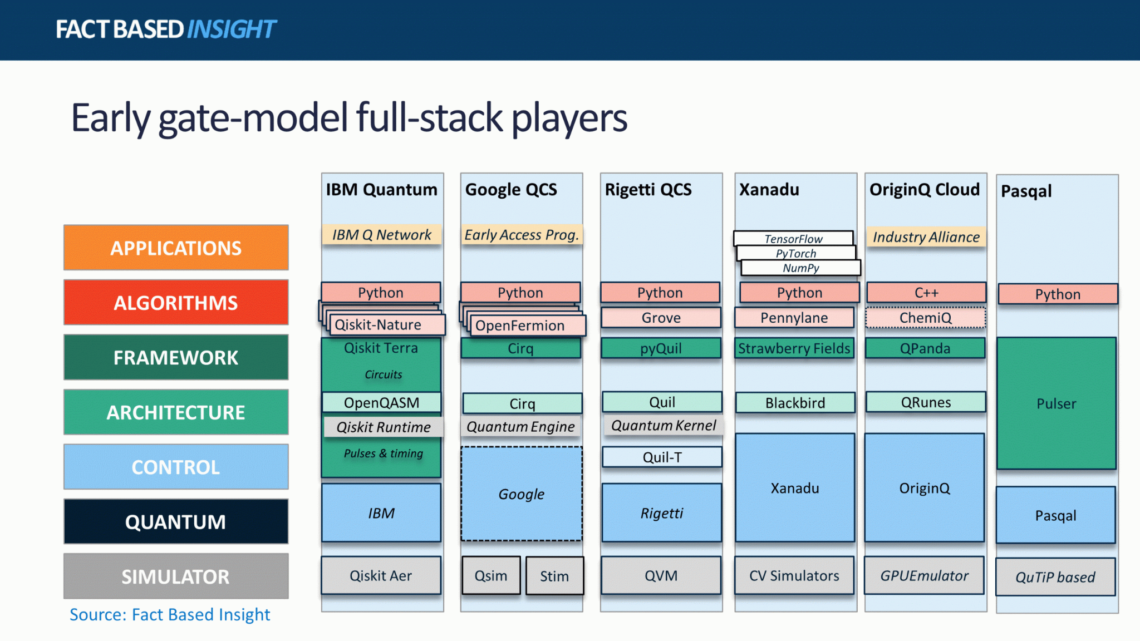
https://quantumcomputingreport.com/quantum-software-outlook-2022/

Slide 5
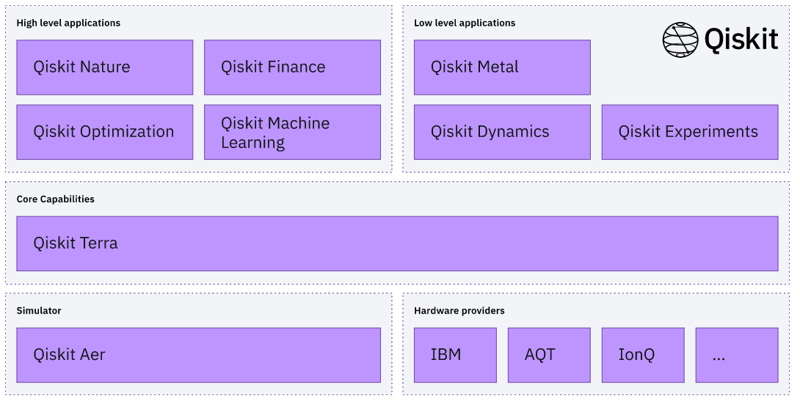
Qiskit is open-source software for working with quantum computers at the level of circuits, pulses, and algorithms
https://qiskit.org/documentation/
pip install qiskit

Slide 6
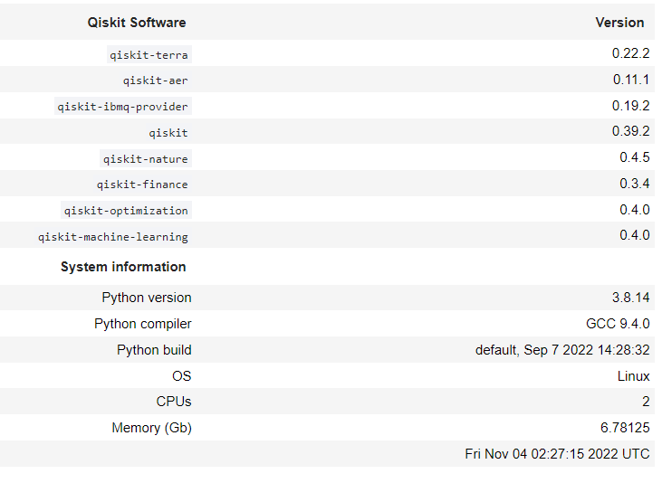

Slide 7
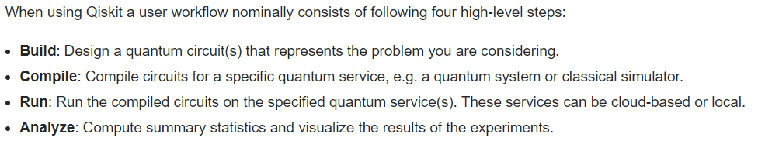

Slide 8
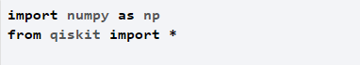
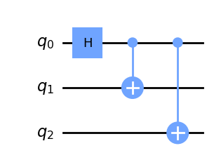
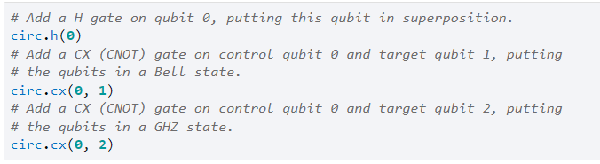
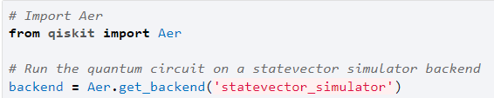
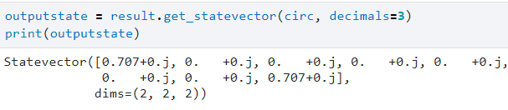
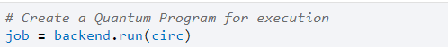
The basic element needed for your first program is the QuantumCircuit
This is taken care by the Qiskit Terra
Simulating circuits using Qiskit Aer

Slide 9
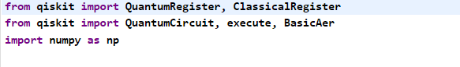
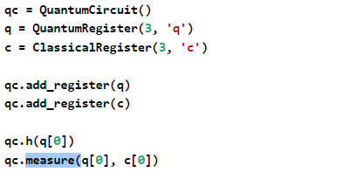
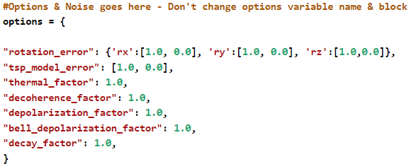
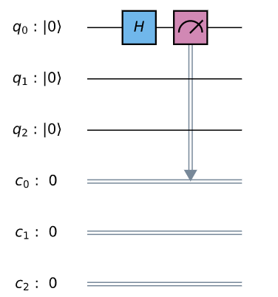
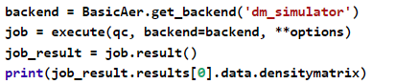
1 - Program on QSim /Density Matrix simulator
2 - Circuit Creation same as provided by Qiskit
Terra
3 – Running Quantum Circuit on QSim and Getting Results

Slide 10
Implementation
Standard formulation of quantum mechanics, states are vectors in a Hilbert space and evolve by unitary transformations, |ψ> → U|ψ>. This evolution is deterministic, continuous and reversible.
It is appropriate for describing the pure states of a closed quantum system, but is insufficient for describing the mixed states that result from interactions of an open quantum system with its environment
The most general description of a quantum system is in terms of its density matrix ρ
https://arxiv.org/abs/1908.05154

Slide 11
Quantum systems are highly sensitive to disturbances from the environment; even necessary controls and observations perturb them.
The available, and upcoming, quantum devices are noisy, and techniques to bring down the environmental error rate are being intensively pursued
It is necessary to come up with error-resilient system designs, as well as techniques that validate and verify the results
https://arxiv.org/abs/1908.05154

Slide 12
This era of noisy intermediate scale quantum systems has been labeled NISQ
Such systems are often special purpose platforms, with limited capabilities
They roughly span devices with 10- 100 qubits, 10-1000 logic operations, limited interactions between qubits, and with no error correction since the fault-tolerance threshold is orders of magnitudes away

Slide 13
A quantum computation may suffer from many sources of error
Imprecise initial state preparation
Imperfect logic gate implementation
Disturbances to the data in memory
Error-prone measurements
So a realistic quantum simulator would have to include all of them with appropriate probability distributions
https://arxiv.org/abs/1908.05154

Slide 14










QSim: Quantum Computer Simulator
Toolkit
Simulate quantum circuits: Simulation of Quantum circuits with custom parameters.
Quantum Noise: Realistic simulator considering effects of noise
Intuitive UI: Intuitive UI/UX helps users to conceptualize and create quantum programs
Examples & Help: Online help, solved examples and learning material.
Secured user management: Secure user management with options to save quantum programs/circuits
Code editor: Advanced Python code editor for Quantum Circuits.

Slide 15
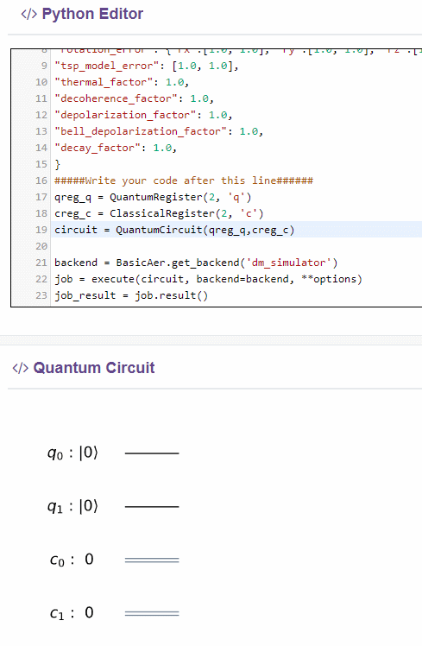
QC Workbench Features
Interactive Python code editor with IDE features such as
Syntax highlighting
Parsing and error checking
Autocompleting keywords and variables
Code folding and unfolding
Automatic braces detecting and closing
Search and replace keywords.
Build and visualize Quantum Circuits

Slide 16
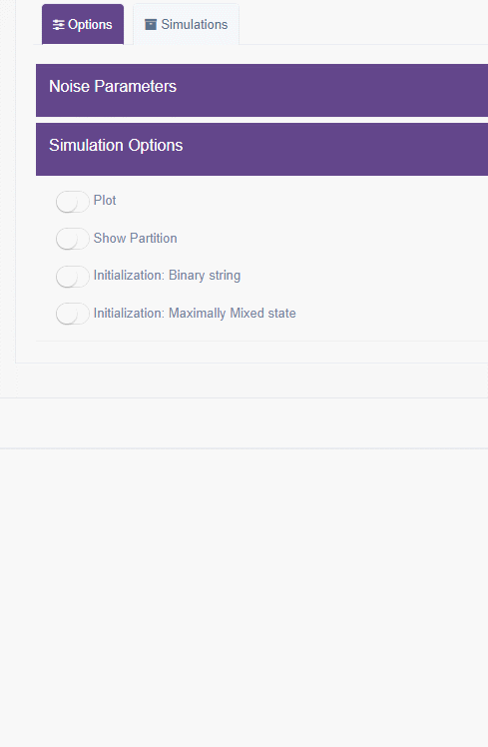
QC Workbench Features
Induce Noise parameters
Rotation Error
TSP Error
Decay factor
Decoherence
Depolarization Factor
Thermal Factor
Bell Depolarization Factor
Customize simulation options
Enable/Disable Plot
Enable/Disable circuit partioning
Circuit initialization options.

Slide 17
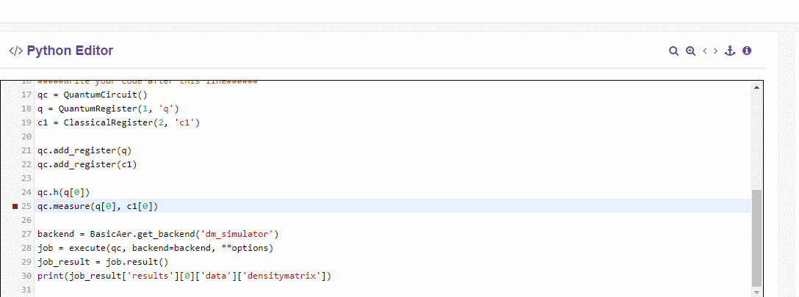
QC Workbench Features
Support for multiple measurement options
Single QuBit measurement
Expectation measurement
Ensemble measurement

Slide 18
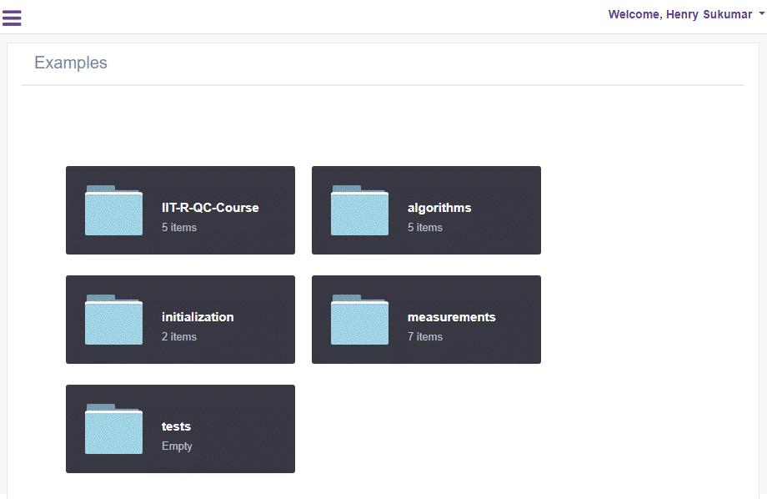
QC Workbench Features
Pre-loaded Quantum examples and algorithms
Deutsch-Jozsa Algorithm
Hubbard model
QFT
Grover's algorithm
Ripple Carry Adder

Slide 19
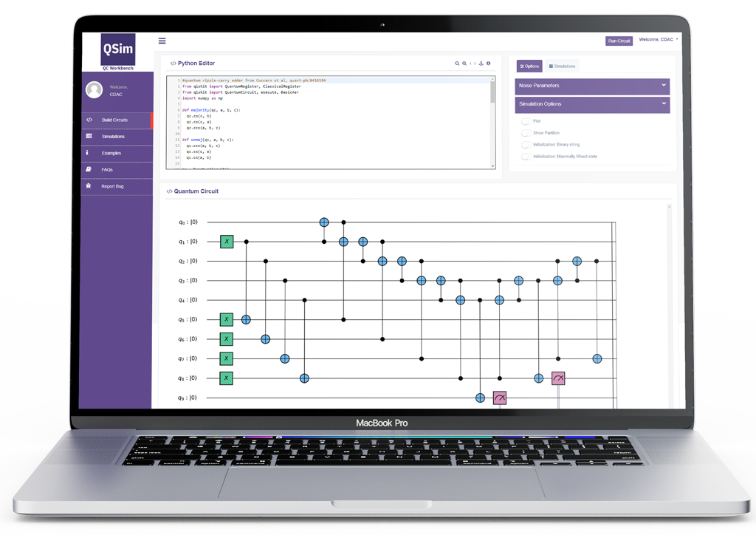
QC Workbench Features
Submit simulations, track progress, fetch results and accounting
Plot and visualization histograms
Integrated Knowledge base & Guides
Secure Login and account management
User simulation statistics
Bug reporting.

Slide 20
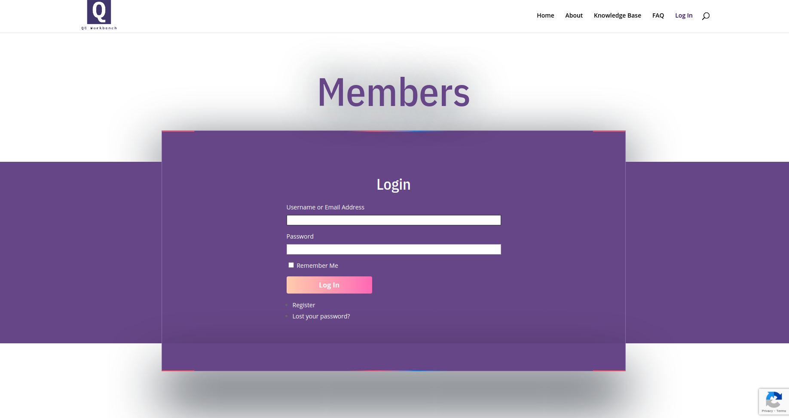
Login Screen (qctoolkit.in)
Notes:
‹#›

Slide 21
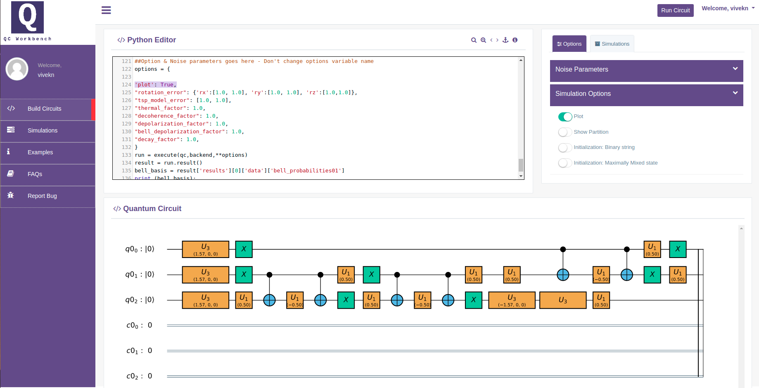
Interactive UI
Notes:
‹#›

Slide 22
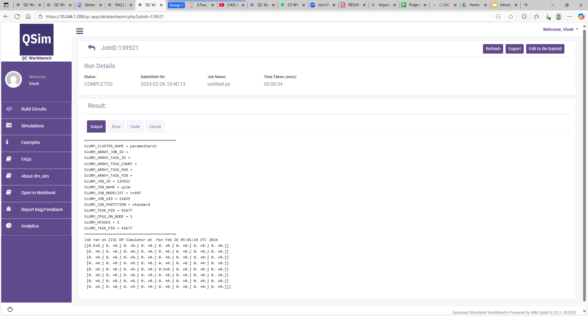

Slide 23
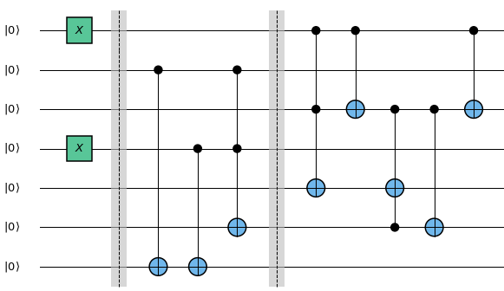
Quantum Circuit for 2-bit Ripple Adder
Input A: 2 = (10)₂
A₁
A₀
B₁
Input B: 1 = (01)₂
B₀
O₂
O₁
Output: 3 = (11)₂
O₀
Credits IIT Roorkee
Bit 0 Half Adder
Bit 1 Full Adder

Slide 24
Installing QSim Locally(On Linux)
#Install rust compiler dependency for new version of qiskit
curl --proto '=https' --tlsv1.2 https://sh.rustup.rs -sSf | sh
#Install miniconda if previously not installed
mkdir -p ~/miniconda3
wget https://repo.anaconda.com/miniconda/Miniconda3-latest-Linux-x86_64.sh -O
~/miniconda3/miniconda.sh
bash ~/miniconda3/miniconda.sh -b -u -p ~/miniconda3
rm -rf ~/miniconda3/miniconda.sh
#can add the miniconda activation in bash by default
~/miniconda3/bin/conda init bash
#Restart the shell so that the environment for miniconda take place or activate the env
source ./miniconda3/bin/activate
#Create a conda environment for installing GPU version of QSim simulator backend
conda create -n qsimenv python=3.8.5
conda activate qsimenv
# Clone the stable version of QSim
git clone -b terra_upgrade https://github.com/indian-institute-of-science-qc/qiskit-aakash.git
cd qiskit-aakash
git checkout -b dev bea98fbff86c234c0b1990add17493a1e86917cb
python -m pip install -e .
python -m pip install jupyterlab
# Launch jupyter lab on terminal
jupyter lab

Slide 25
Additional Resource For QC
Here are the links for the 2020 Quantum Computing Course conducted by IIT Roorkee
https://github.com/deadbeatfour/quantum-computing-course
https://www.youtube.com/playlist?list=PLyEHBEYaB52XCMH9mMHo5MAzGcZkcdVGB
Here are the links for the 2023 Quantum Computing Course conducted by IIT Roorkee
https://github.com/gitkarma/quantum_computing_course2023
https://www.youtube.com/playlist?list=PLt_nrfusQeEdYto6Qh2hkD7EcCQ-7QHFk
Here are the links for the 2025 Quantum Computing course
https://github.com/gitkarma/quantum_computing_course2025
https://www.youtube.com/playlist?list=PLt_nrfusQeEc-5tBqiQkmt70Aeu_zNiNT
Introduction to Quantum Computation by IISc Bangalore
https://www.youtube.com/watch?v=-t8IvCAzeKY&list=PLNrdQx59gmEWV7eLbqDWeI_B72-0MXiyt

Slide 26
Representing the state of qubits using the state-vector notation
Convenient when dealing with states that can always be expressed as a linear combination of basis states
There are many practical scenarios in which the state of our qubits cannot be written down as linear combinations in a given basis
But instead, must be expressed in terms of ensembles (statistical mixtures) of multiple states
Density matrix is an alternative way of expressing quantum states
https://qiskit.org/textbook/ch-quantum-hardware/density-matrix.html

Slide 27
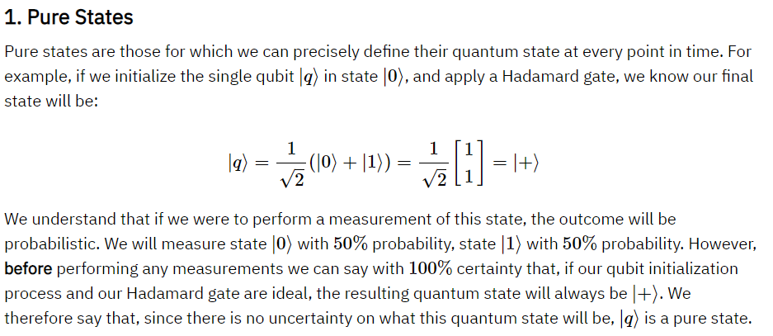
https://qiskit.org/textbook/ch-quantum-hardware/density-matrix.html#1.-Pure-States-

Slide 28
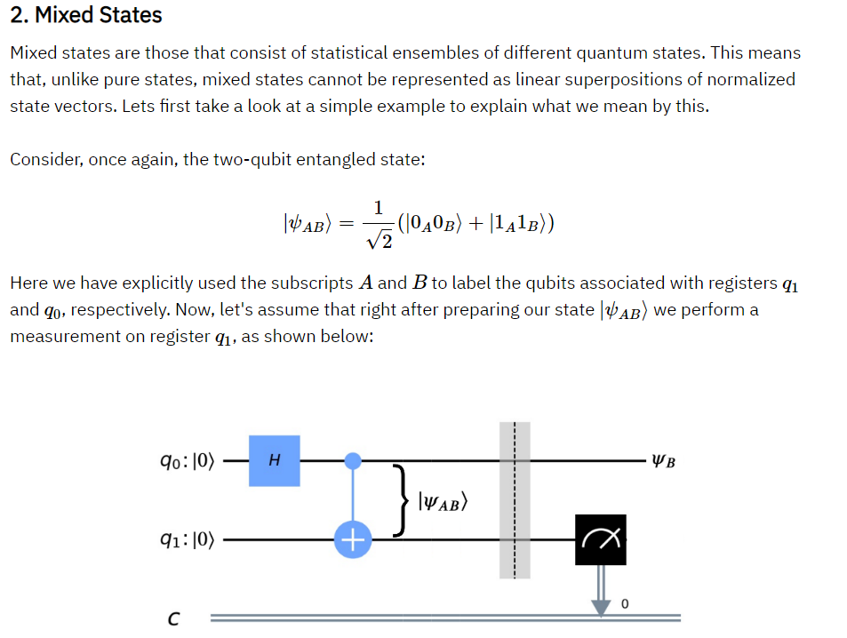
https://qiskit.org/textbook/ch-quantum-hardware/density-matrix.html#2.-Mixed-States-

Slide 29
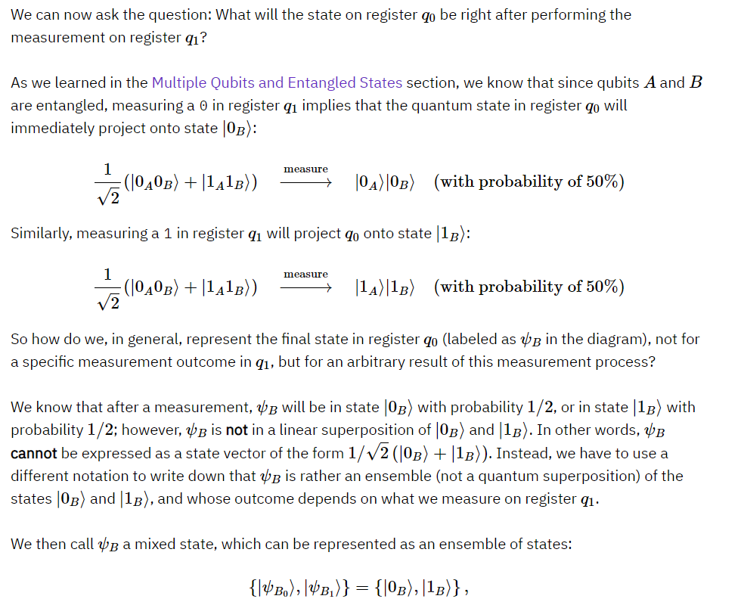
https://qiskit.org/textbook/ch-quantum-hardware/density-matrix.html#2.-Mixed-States-

Slide 30
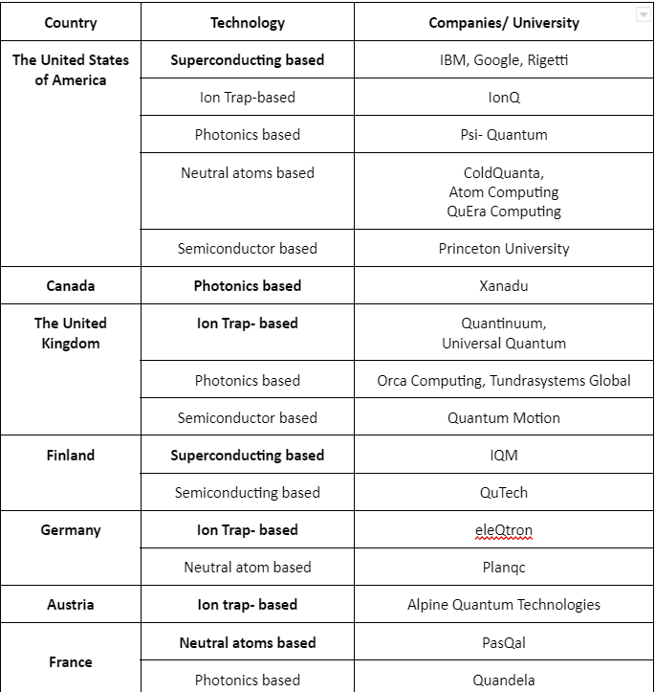

Slide 31
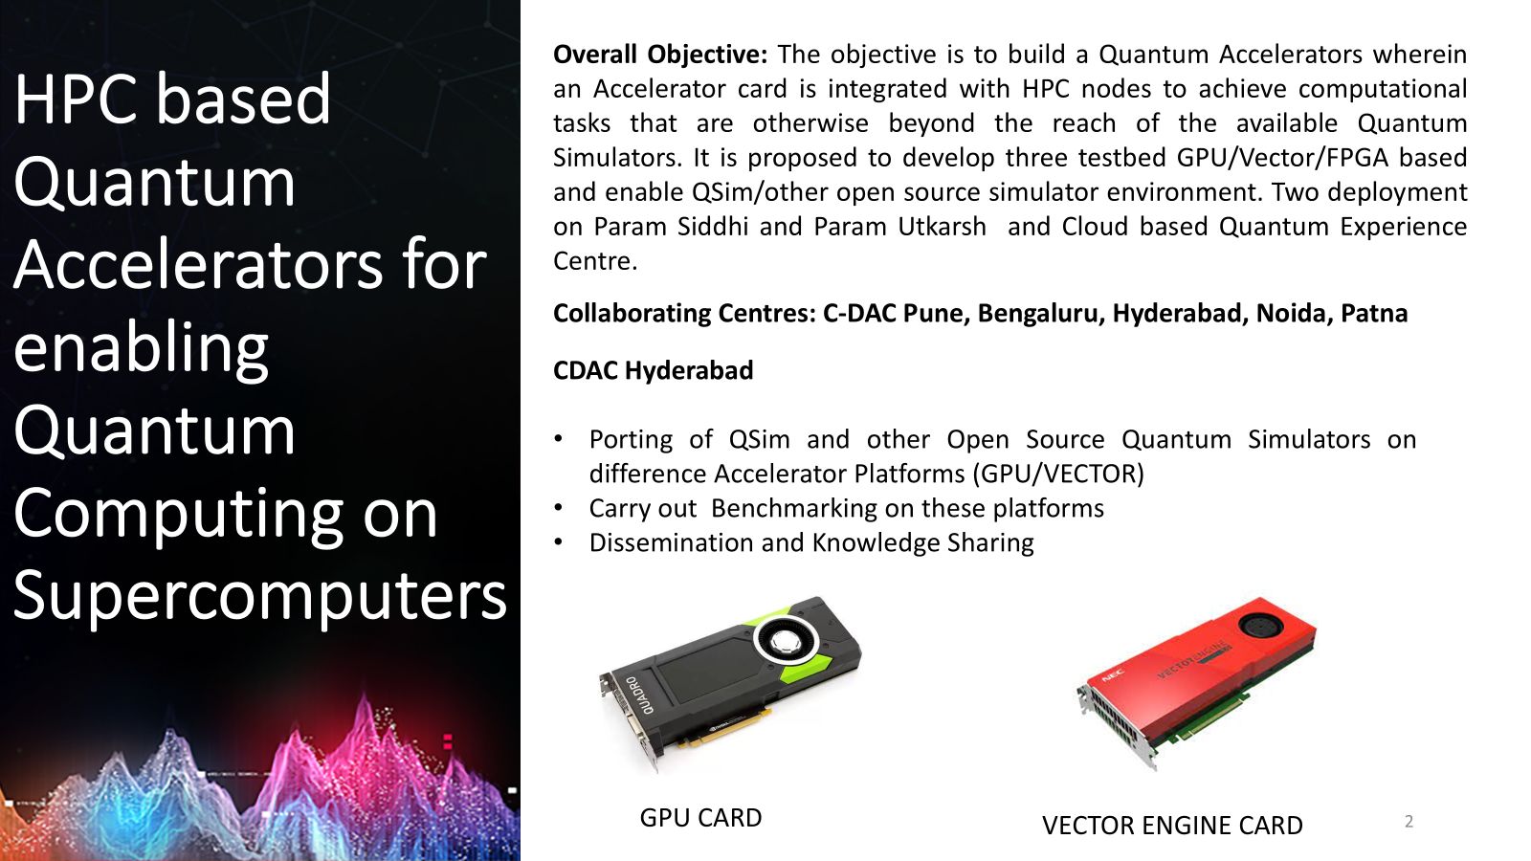
Additional Resource For QC
Here are the links for the 2020 Quantum Computing Course conducted by IIT Roorkee
https://github.com/deadbeatfour/quantum-computing-course
https://www.youtube.com/playlist?list=PLyEHBEYaB52XCMH9mMHo5MAzGcZkcdVGB
Here are the links for the 2023 Quantum Computing Course conducted by IIT Roorkee
https://github.com/gitkarma/quantum_computing_course2023
https://www.youtube.com/playlist?list=PLt_nrfusQeEdYto6Qh2hkD7EcCQ-7QHFk
Here are the links for the 2025 Quantum Computing course
https://github.com/gitkarma/quantum_computing_course2025
https://www.youtube.com/playlist?list=PLt_nrfusQeEc-5tBqiQkmt70Aeu_zNiNT
Introduction to Quantum Computation by IISc Bangalore
https://www.youtube.com/watch?v=-t8IvCAzeKY&list=PLNrdQx59gmEWV7eLbqDWeI_B72-0MXiyt

Slide 32
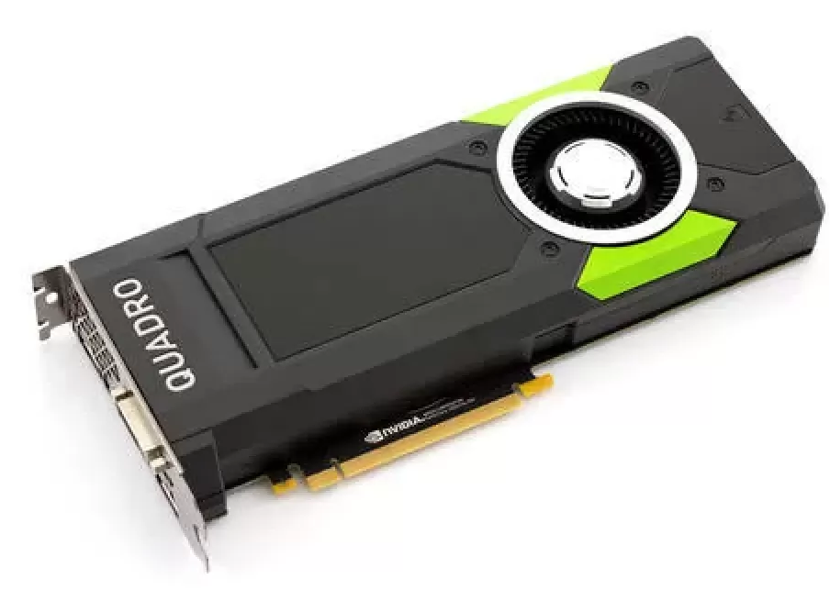
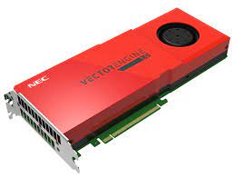
QSim for VECTOR Processors
QSim (dm_simulator ) (simulate noisy quantum logic circuits using the density matrix formalism)
Current status (dm_simulator)- Available for GPU
Porting over vector processors and making it available over the HPC QA Testbed
Benchmarking the ported version
Upgrades and Support
VECTOR ENGINE CARD
GPU CARD

Slide 33
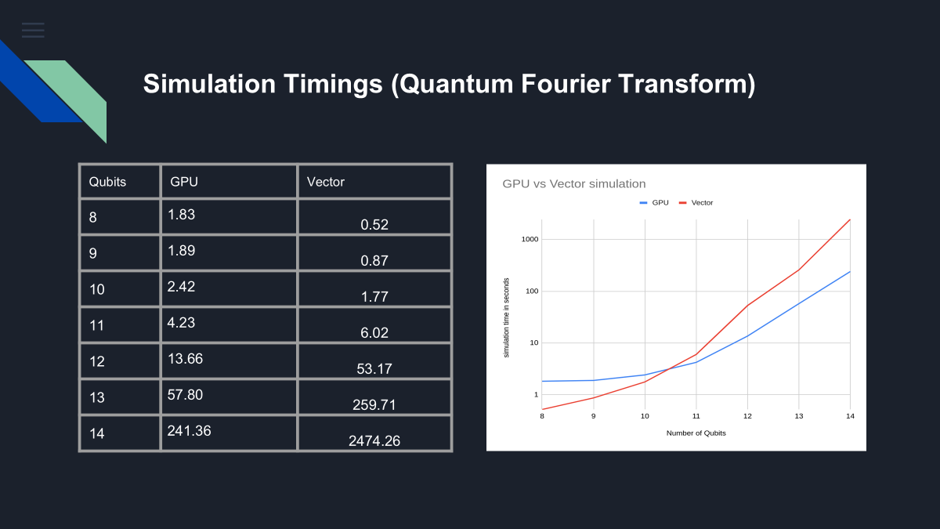
QSim
○GPU: Nvidia RTX A5000 (24GB)
○CPU Cores: 96
○System RAM: 256 GB
○NEC Vector Engine: VE20B Tsubasa SX-Aurora (48 GB)
○CPU Cores: 64
○System RAM: 512 GB

Slide 34
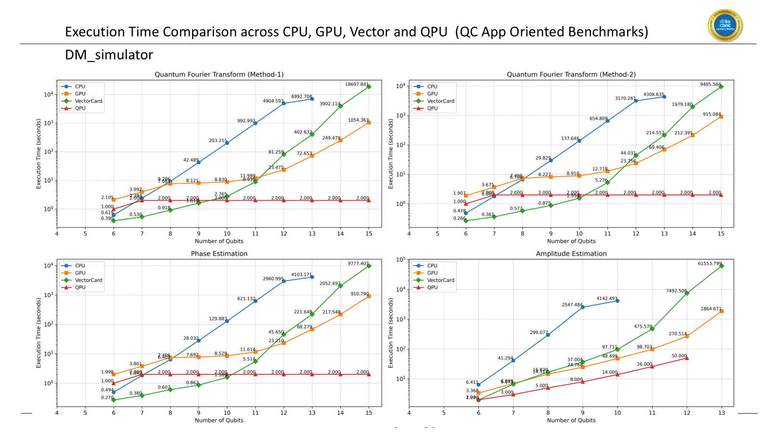
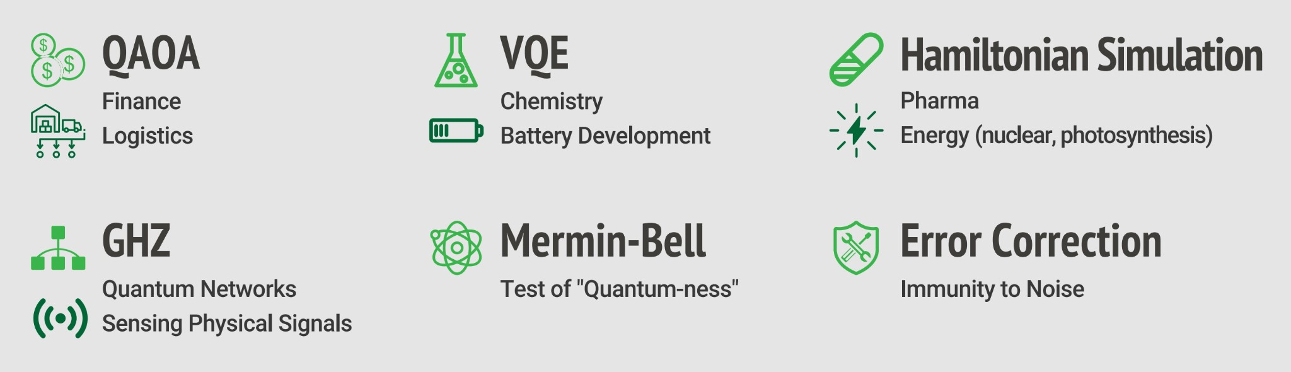
Benchmarking
Performance for real application on the available testbeds
GPU/VECTOR/FPGA and available Quantum hardware
Identification of benchmarks methodologies
Application-level benchmarks and profiling
QAOA, VQE ,Hamiltonian Simulation, GHZ etc..
SupermarQ: A Scalable Quantum Benchmark Suite , [2202.11045] SupermarQ: A Scalable Quantum Benchmark Suite

Slide 35
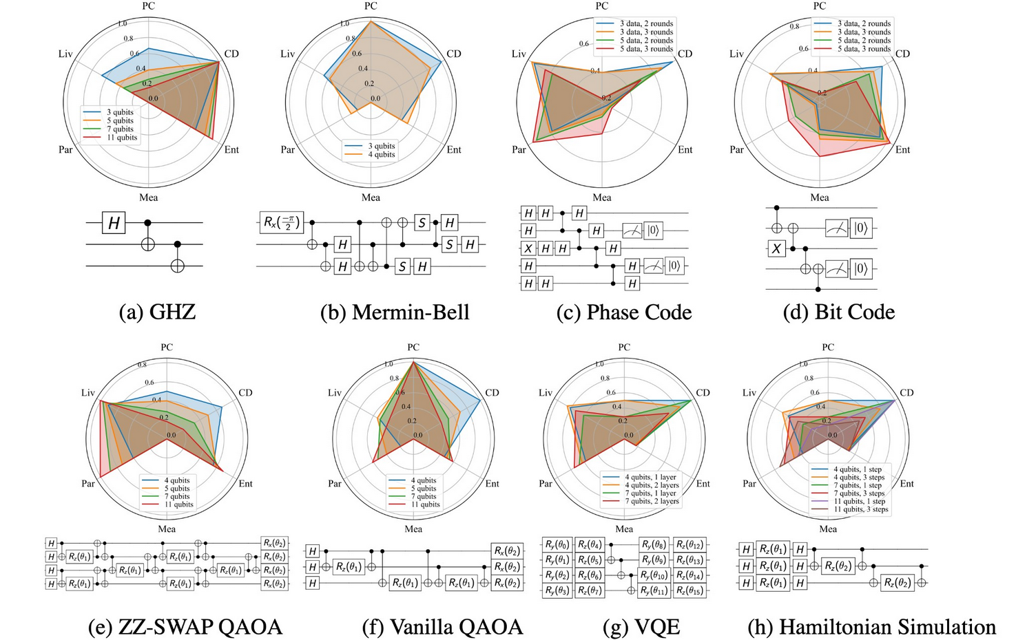
Feature maps and sample circuits for each benchmark
(SupermarQ Benchmarking Framework)
Figure: Feature maps and sample circuits for each of the benchmarks evaluated
Program Communication
Critical-Depth
Entanglement-Ratio
Parallelism
Liveness
Measurement
SupermarQ: A Scalable Quantum Benchmark Suite ,[2202.11045] SupermarQ: A Scalable Quantum Benchmark Suite

Slide 36
Feature Description (SupermarQ )
Program Communication: Captures the level of interaction required between qubits, ranging from simple nearest-neighbor interactions to fully connected communication. This is critical for understanding the impact of qubit connectivity in a quantum device.
Critical Depth: Quantifies the total number of computational steps or layers in a quantum circuit, indicating temporal complexity and the influence of coherence times.
Entanglement-Ratio :quantifies the level of entanglement present in a quantum circuit. It measures the proportion of qubits involved in multi-qubit entanglement during the execution of a quantum program
Parallelism: Highlights the simultaneous execution of quantum gates across different qubits, offering insights into the utilization efficiency of available hardware.
Liveness: Liveness quantifies the fraction of qubits that perform meaningful operations (gates or measurements) as opposed to being idle during a given time frame,It reflects how evenly computational work is distributed across the available qubits
Measurement Density: Indicates how frequently measurements occur, affecting error propagation and overall accuracy.
https://arxiv.org/pdf/2202.11045

Slide 37
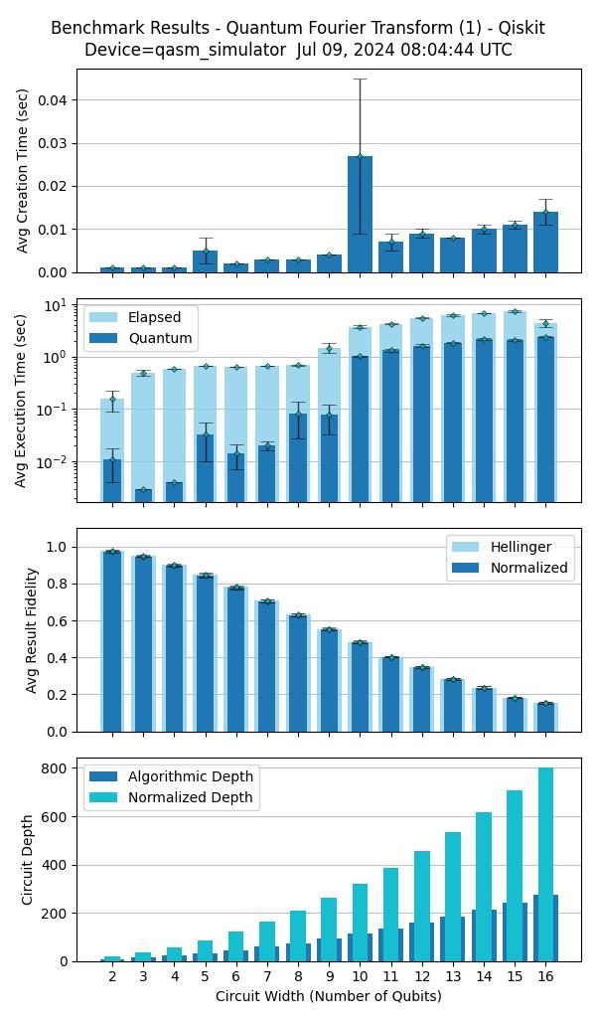
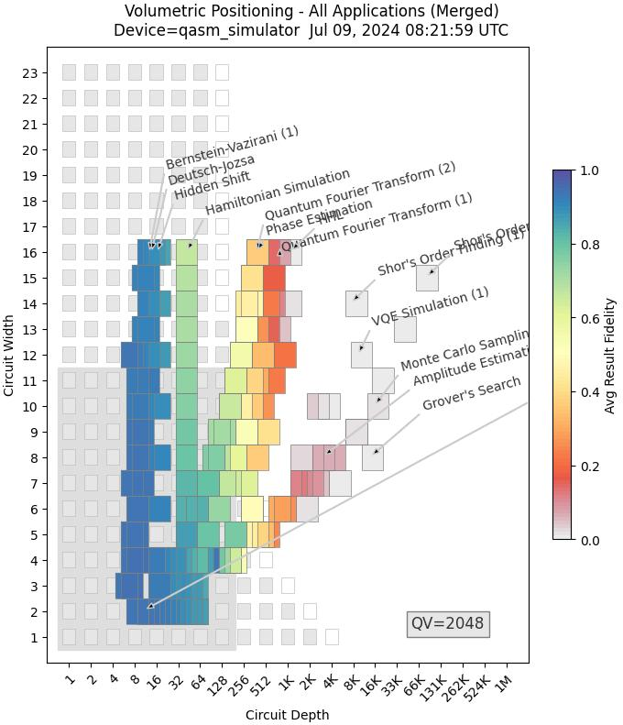
Bench marking over GPU A100 for Qasm simulator
GitHub - SRI-International/QC-App-Oriented-Benchmarks: QED-C: The Quantum Economic Development Consortium provides these computer programs and software for use in the fields of quantum science and engineering.

Slide 38
https://tinyurl.com/qsim2024
qctoolkit.in

Slide 39
https://tinyurl.com/qsim2024
qctoolkit.in
(qcworkbench@cdac.in) Email for requesting access
https://qniverse.in
https://qniverse.in/getting-access-qniverse/

